Slide 1
DA_301 Turtle Games analysis
Weerakoon Dinushi
July 2023

Slide 2
Improvement towards sales performance
how customers accumulate loyalty points
how groups within the customer base can be used to target specific market segments
how social data (e.g. customer reviews) can be used to inform marketing campaigns
the impact that each product has on sales
how reliable the data is (e.g. normal distribution, skewness, or kurtosis)
the relationship(s) is/are (if any) between North American, European, and global sales?

Slide 3
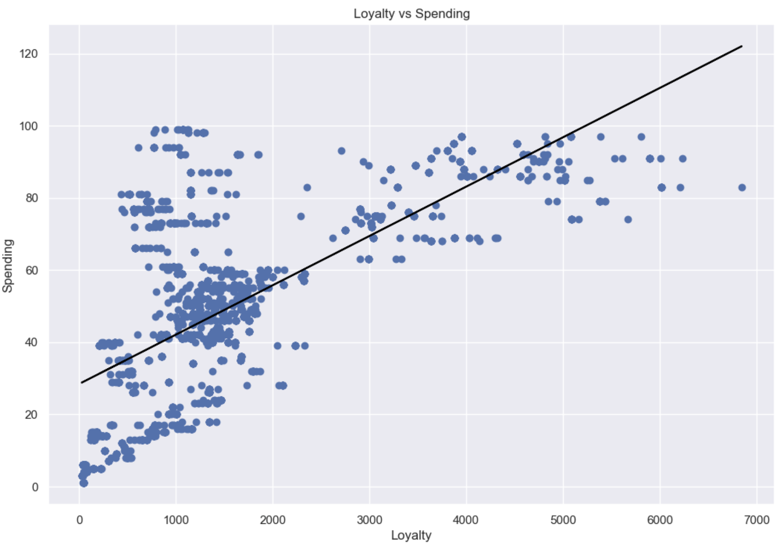
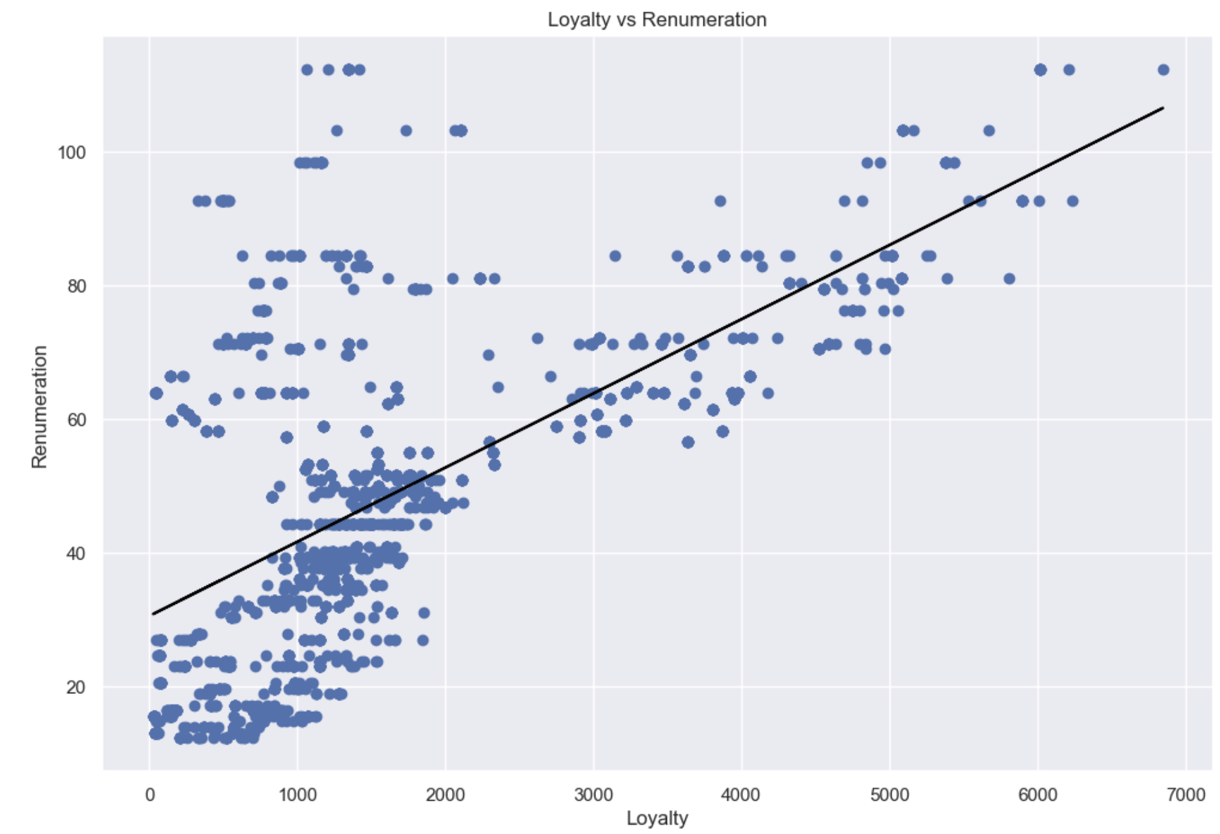
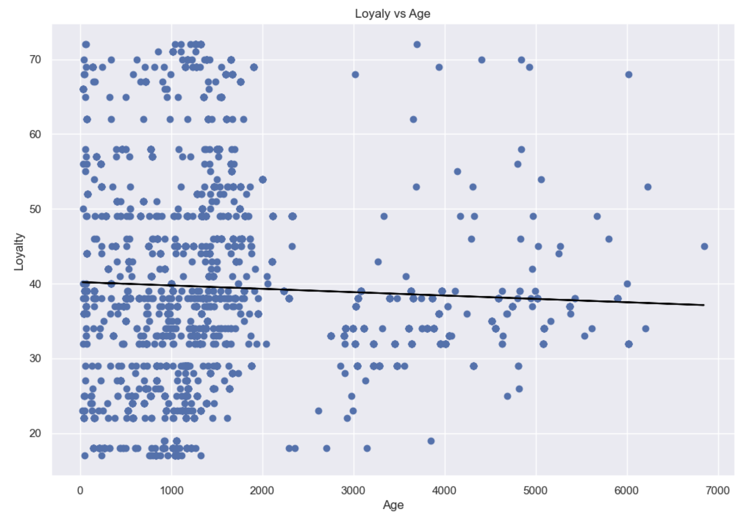
How customers accumulate loyalty points
Based on data on salary and spending
Loyalty and spending
Loyalty and salary
Loyalty and age

Slide 4
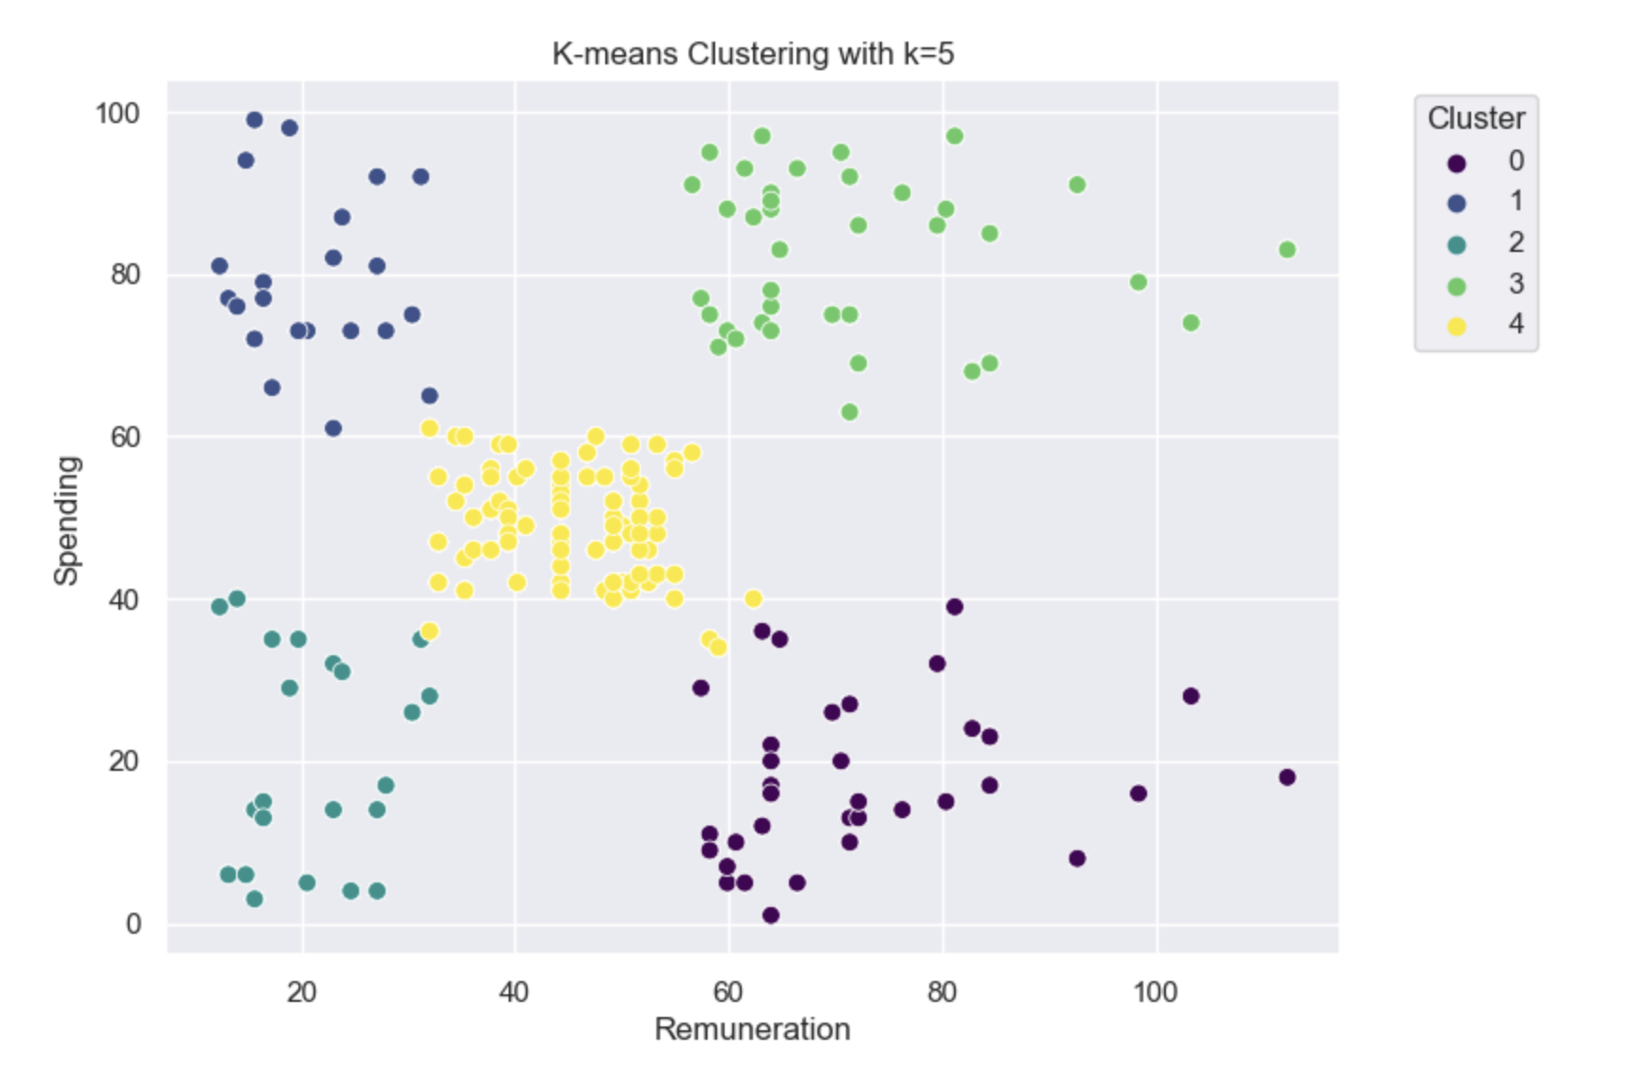
How groups within the customer base can be used to target specific market segments
Based on data on salary and spending

Slide 5
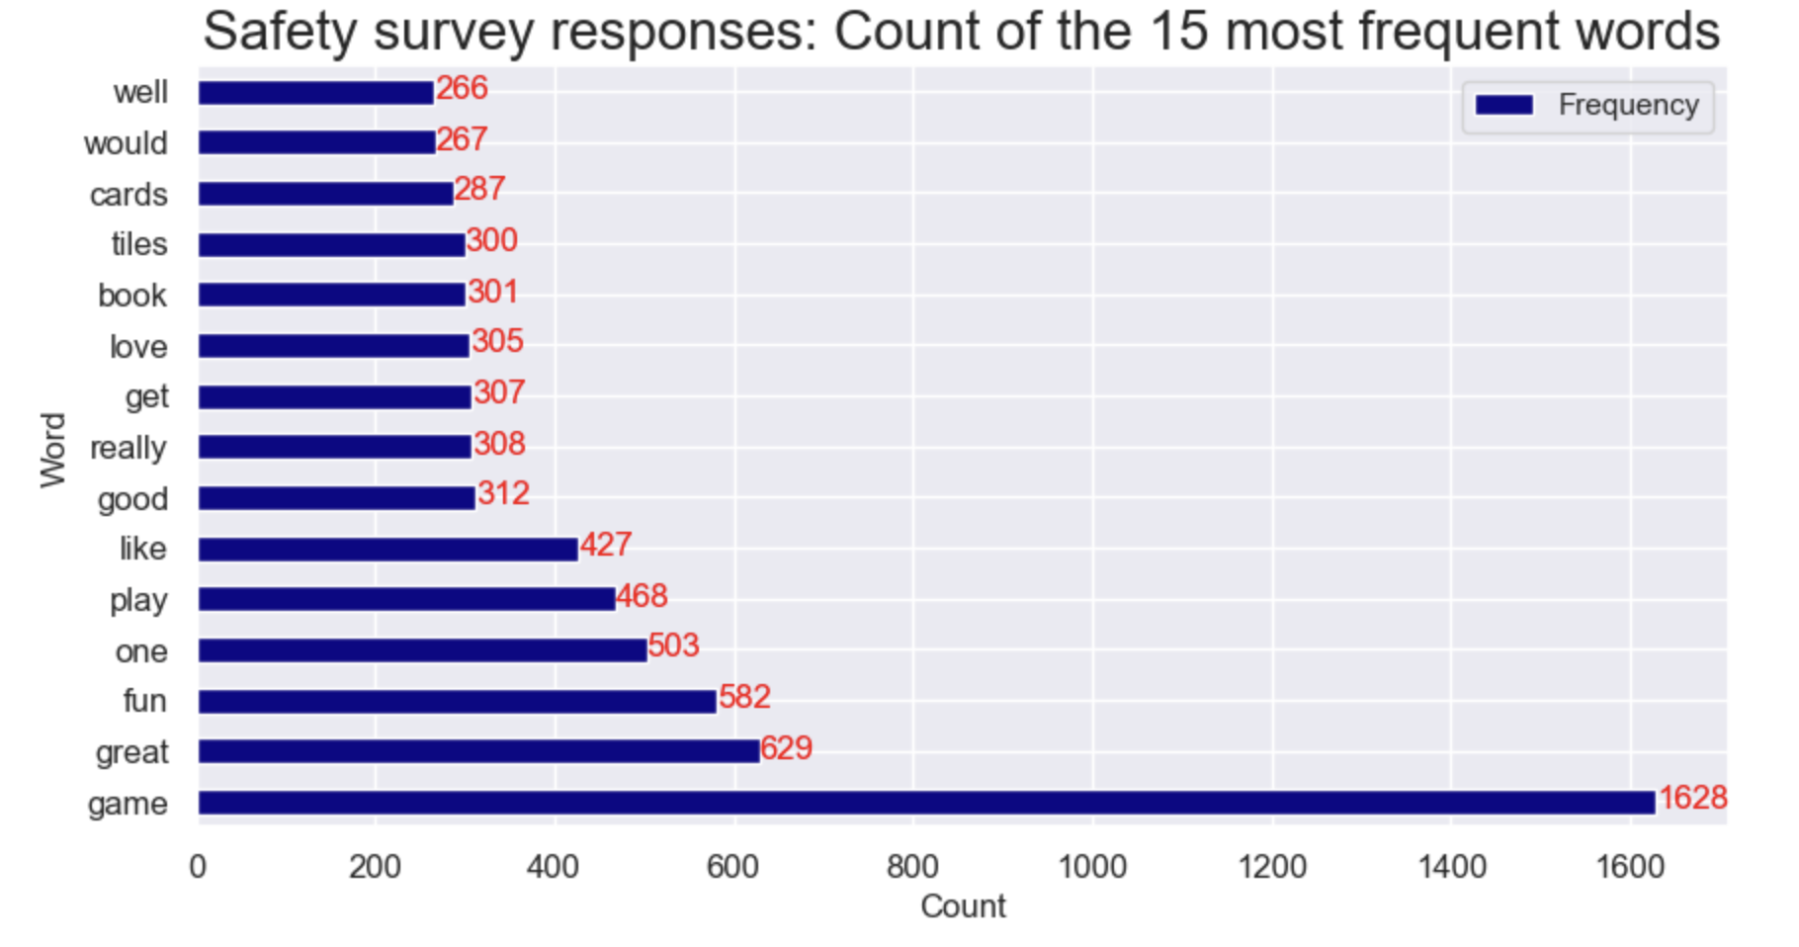
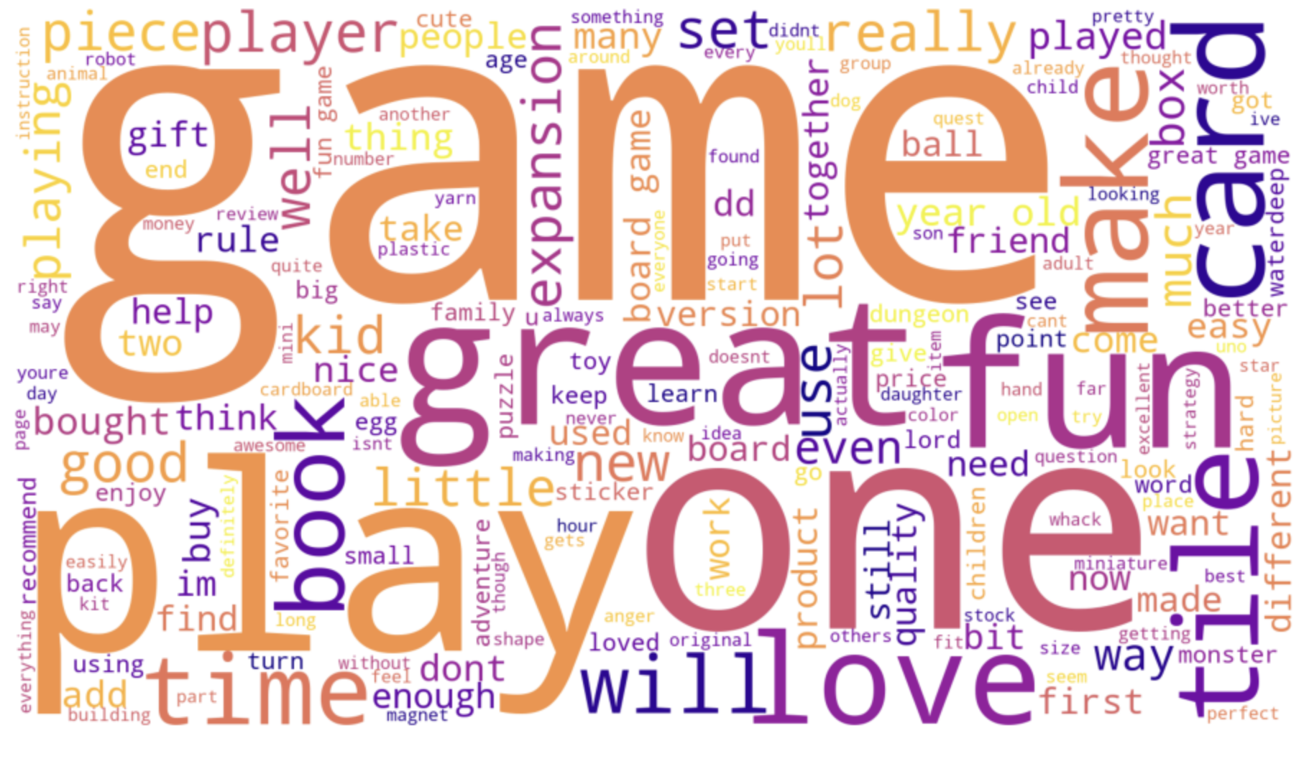
How social data (e.g. customer reviews) can be used to inform marketing campaign

Slide 6
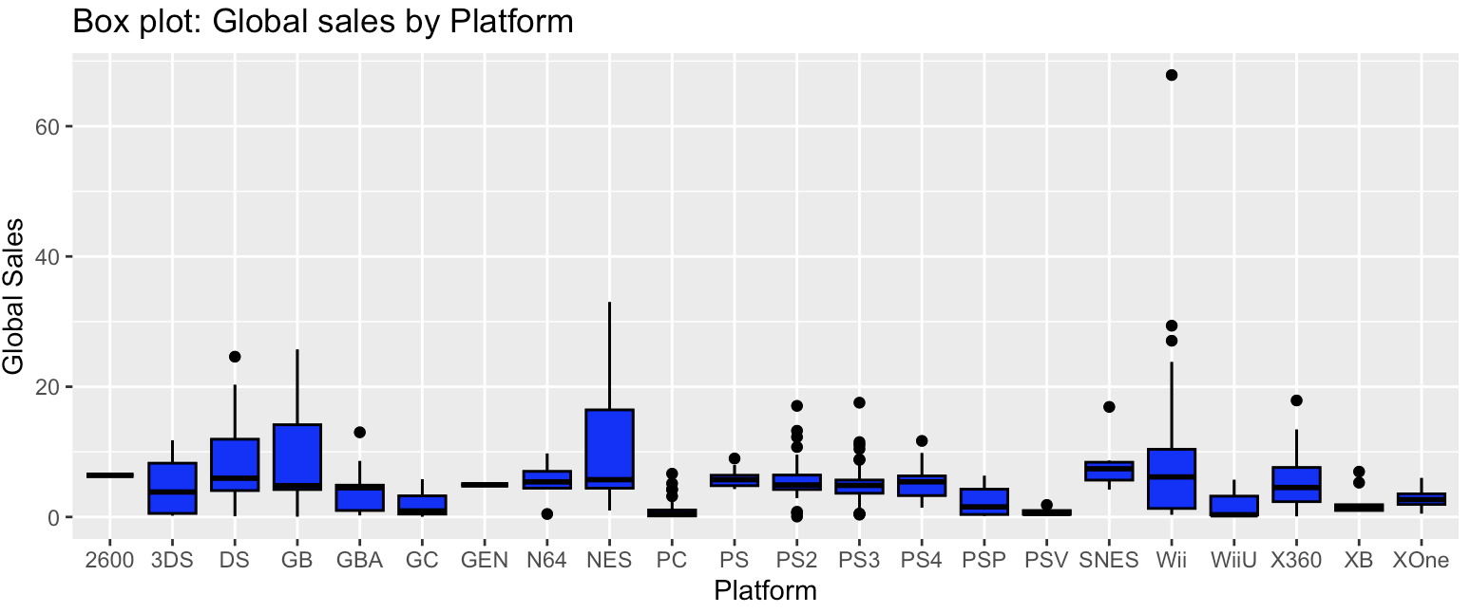
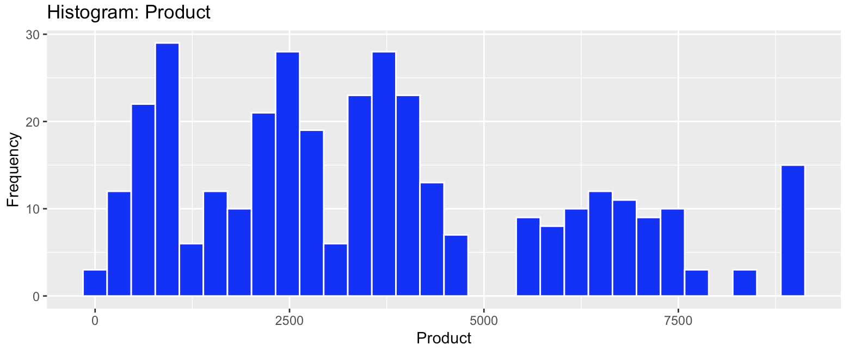
The impact that each product has on sales

Slide 7
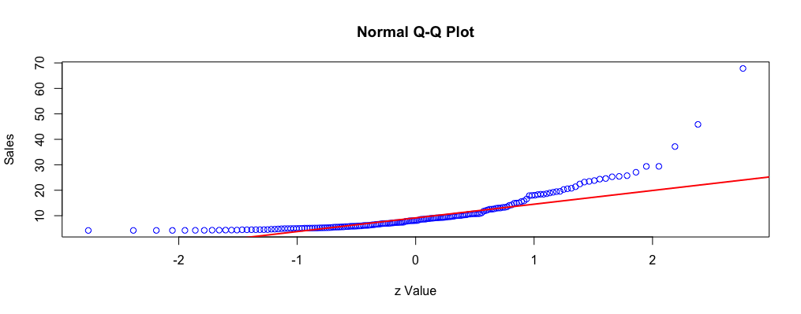
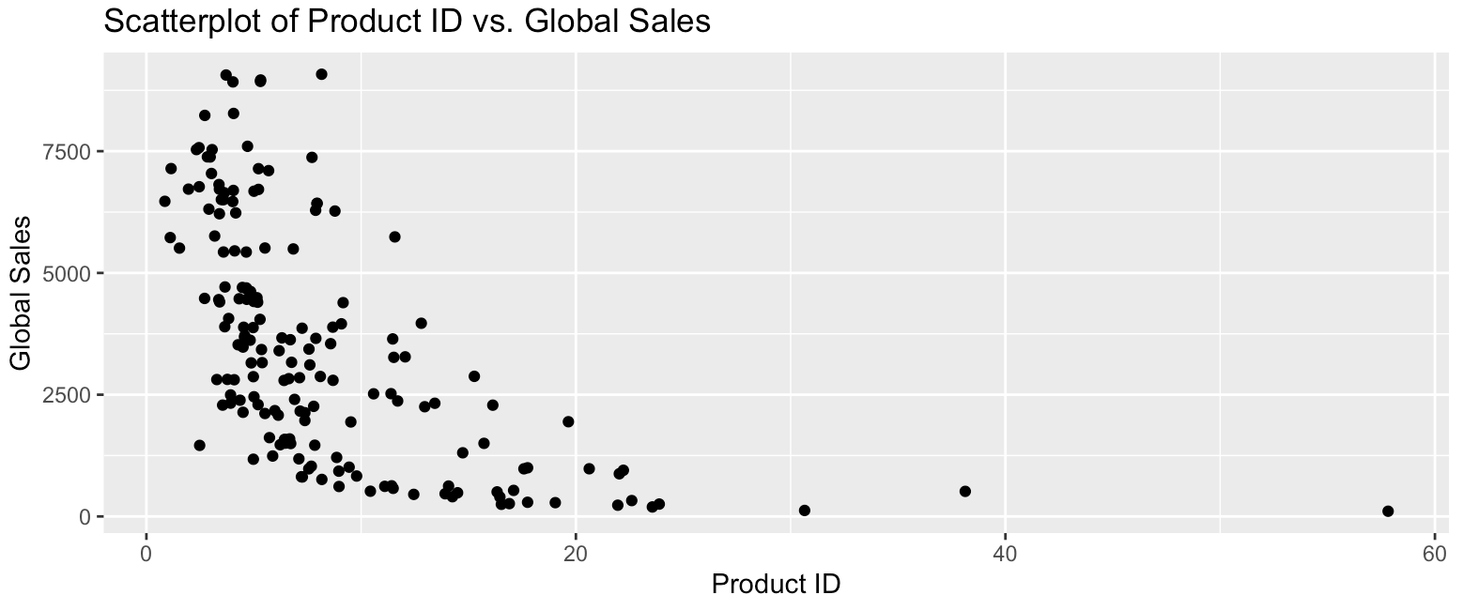
How reliable the data is (e.g. normal distribution, skewness, or kurtosis)

Slide 8
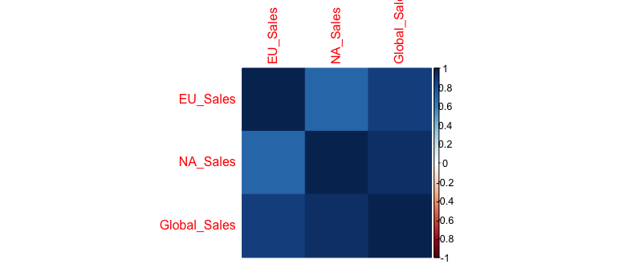
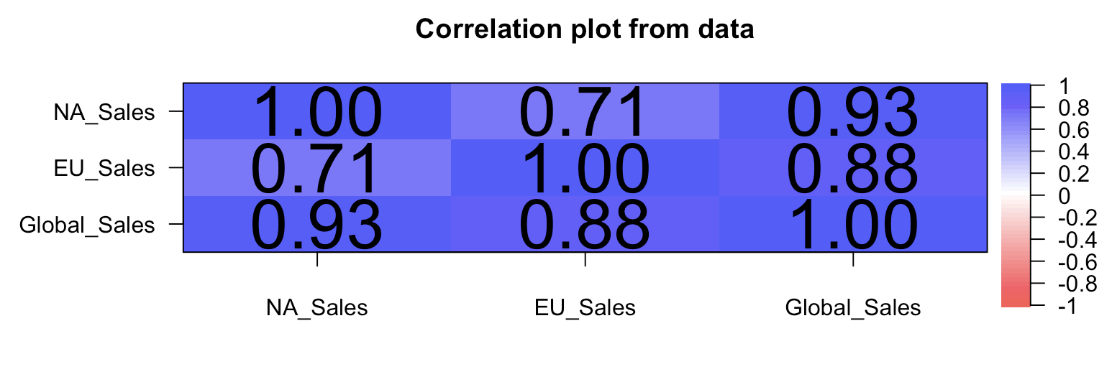
The relationship(s) is/are (if any) between North American, European, and global sales?

Slide 9
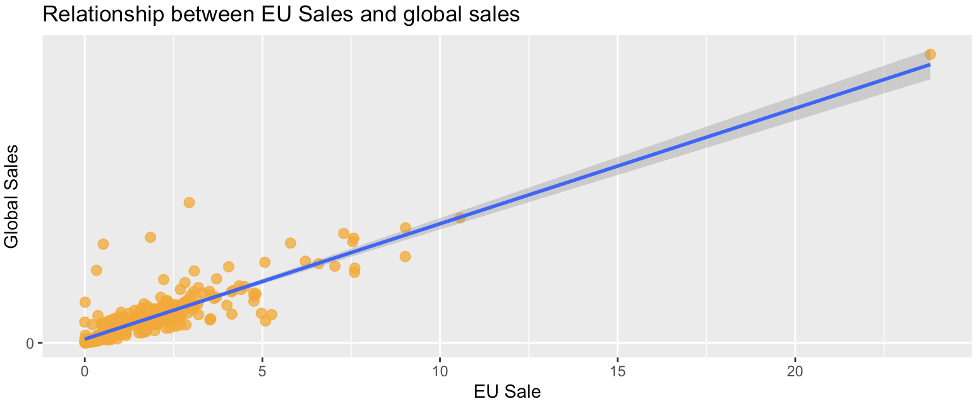
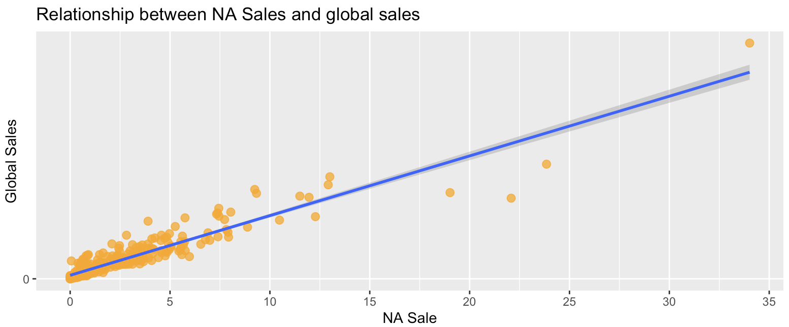
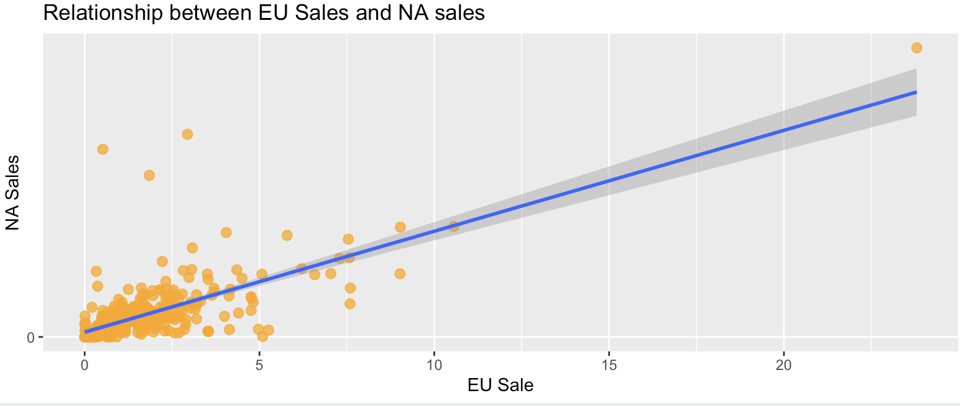

Slide 10
Recommendation

Slide 11
Thank you

